Slide 1
Accurate Mesh Simplification Using Genetic Algorithms
Caleb Skinner

Slide 2
Introduction

Slide 3
Background Information
Mesh Simplification – reducing the number of faces/vertices/edges used to represent a 3D model
Accurate mesh simplification is difficult for machines
Must account for visual accuracy of the simplified model
Often easier to manually simplify a mesh
Popular mesh simplification techniques
Vector clustering
Edge Removal
Genetic algorithms rarely used for mesh simplification

Slide 4
Methodology

Slide 5
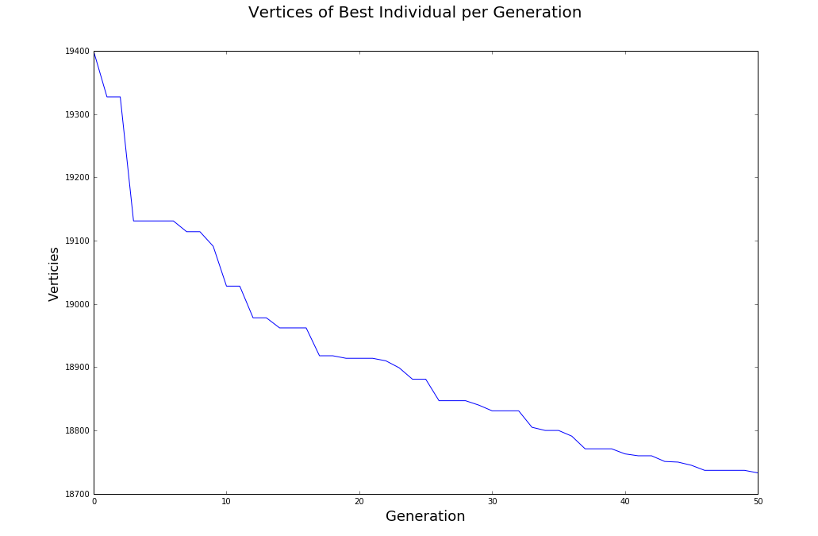
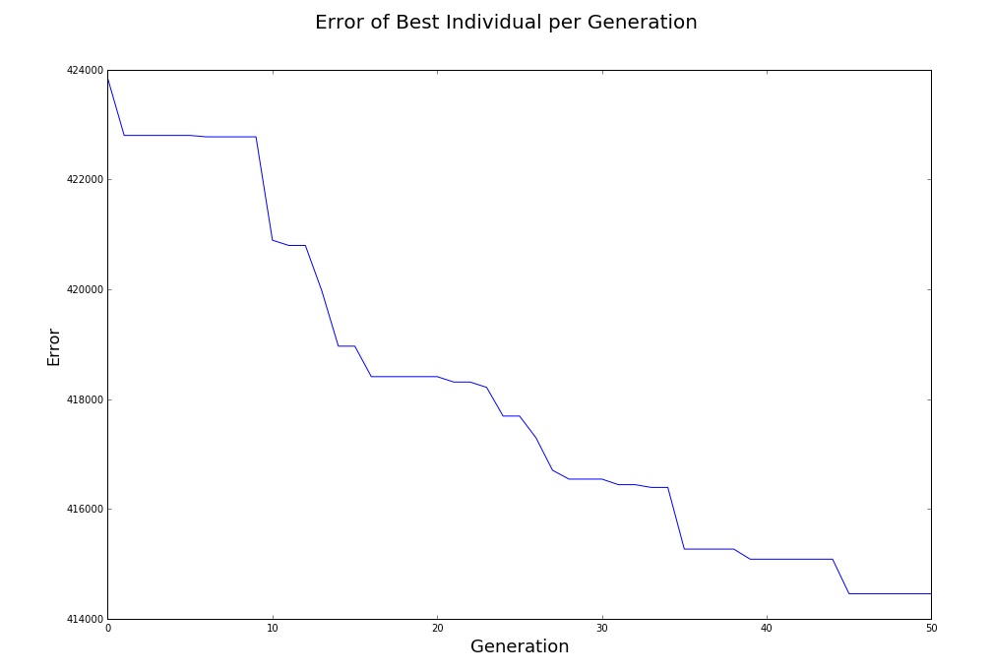
Genetic Algorithm
Multi-objective genetic algorithm
Number of Vertices
Error(Visual accuracy)
Wanted to incorporate vertex importance from vector clustering techniques
Error function is a absolute value function

Slide 6
Individuals
Vertices
(x, y, z) | 0
(x, y, z) | 1
(x, y, z) | 2
... | …
(x, y, z) | n - 1
Binary-coded
List the same size as the number of vertices in the model
List randomly filled with 1s and 0s
1 indicates that the corresponding vertex in the list of will be included in the model
0 | 1 | 2 | … | n-1
1 | 0 | 1 | … | 1
0 | 1 | 2 | … | n-1

Slide 7
Crossover
Uniform Crossover
Random swaps the elements at a specific index in two individuals
70% chance
Individual 1 | 1 | 0 | 1 | … | 1
Individual 1 | 1 | 1 | 0 | … | 1
Individual 2 | 1 | 0 | 1 | … | 0
Individual 2 | 1 | 1 | 0 | … | 0

Slide 8
Mutation
Index Shuffling
20% chance
1
0
0
1
Individual | 1 | 0 | 0 | 1

Slide 9
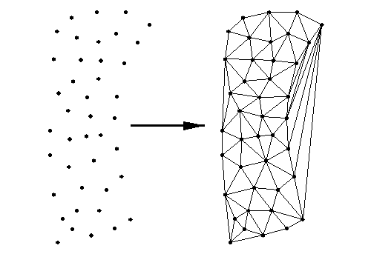

Fitness Evaluation
Triangulation
Edges added to tringles such that no triangles overlaps
Calculation of Error
Error = $\sum_{n=0}^{n−1}{\text{|}\text{zor}\text{ginal}\text{ – }\text{znew}\text{|}}$
Digital image. Http://rebeccablueclassroom.weebly.com/triangulation.html.

Slide 10
Selection
NSGA-II
Individuals are sorted in order of their distance from other individuals (far = good)
N best individuals are selected

Slide 11
Results

Slide 12
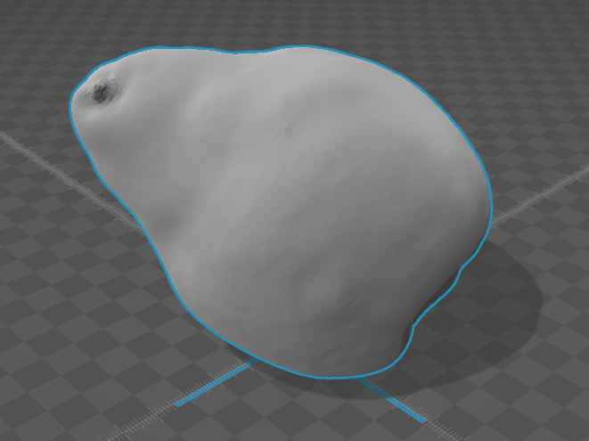
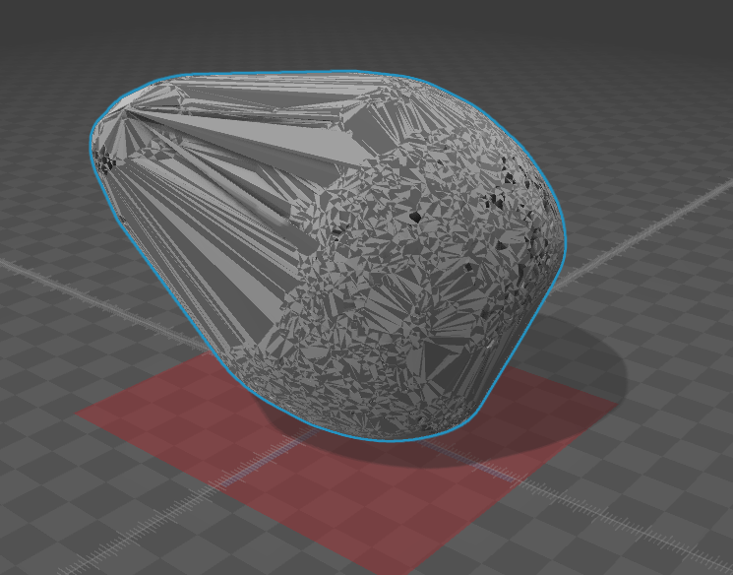
Pear
234330 vertices
18733 vertices

Slide 13
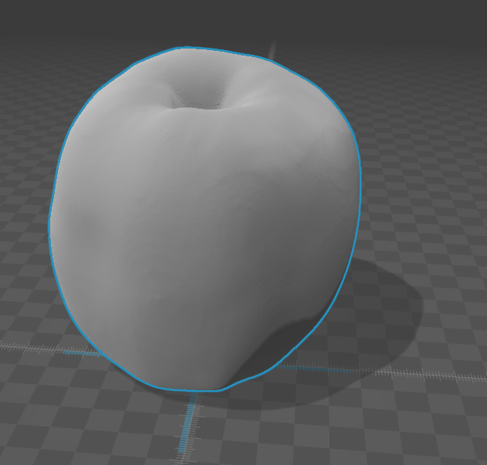
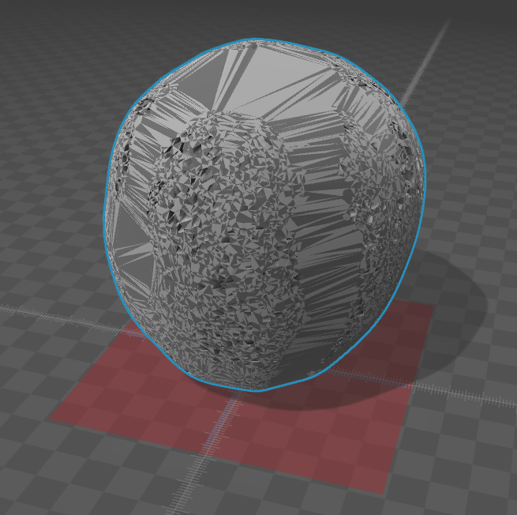
Apple
45882 vertices
22155 vertices

Slide 14
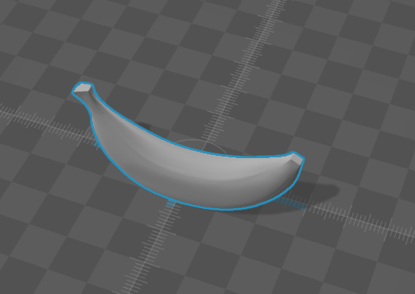
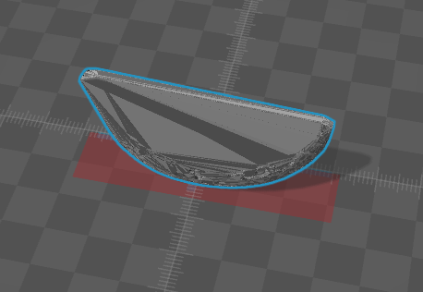
Banana
117198 vertices
9363 vertices

Slide 15
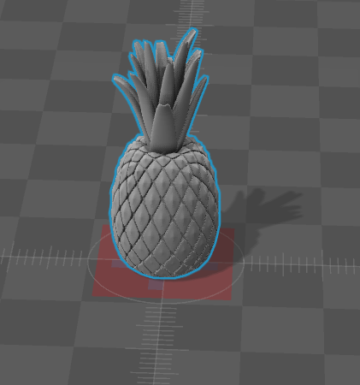
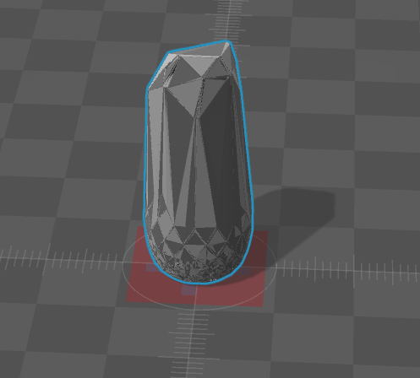
Pineapple
234564 vertices
18816 vertices

Slide 16
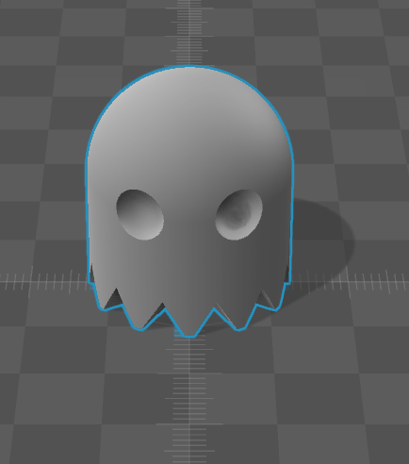
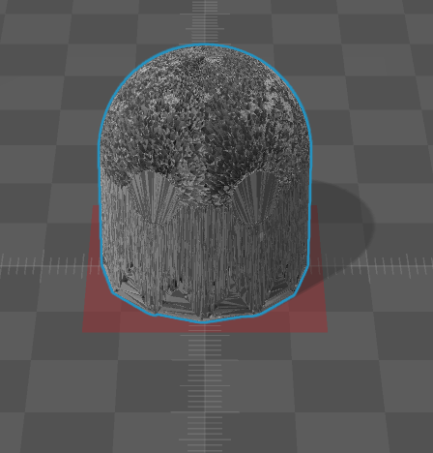
Pacman Ghost
323610 vertices
26318 vertices

Slide 17
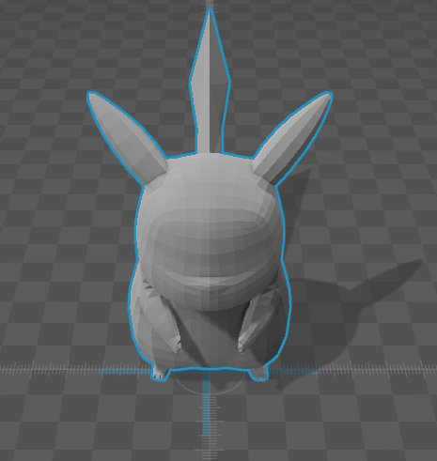
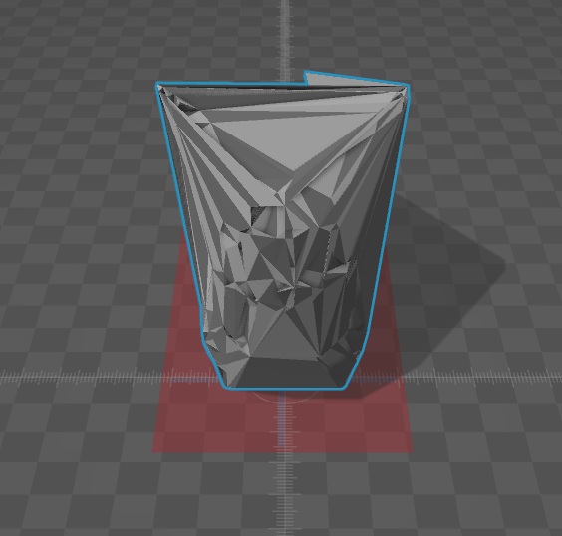
Pikachu
8298 vertices
566 vertices

Slide 18
Questions?

